Slide 1
AGRICULTURE PORTFOLIO
STUDENT NAME
REGISTER NO NMIS
DEPARTMENT
COLLEGE
UNIVERSITY
:
:
:
:
:
Priya .A
asunm189222403111
Bsc computer science
CsiEwart women's Christian college
Madras University

Slide 2
PROJECT TITLE
Agriculture portfolio front end web development

Slide 3


AGENDA
Problem Statement
Project Overview
End Users
Tools and Technologies
Portfolio design and Layout
Features and Functionality
Results and Screenshots
Conclusion
Github Link
3/21/2024 Annual Review

Slide 4

PROBLEM STATEMENT
Agriculture, being the backbone of many economies, faces challenges such as low productivity, climate change, soil degradation, and inefficient use of resources. Farmers often struggle with lack of access to modern technology, reliable market prices, and sustainable farming practices, which hampers both their income and food security.

Slide 5

PROJECT OVERVIEW
Agriculture sustains life by providing food and resources but faces challenges needing sustainable solutions.
What your portfolio content about me,skils,tecnologies,contect
main idea showcase skils, tecnologies

Slide 6

WHO ARE THE END USERS?
Food processing industries
Textile industries
Export Mark &trade
Farmers &rules community
:
:
:
:
raw crops into packaged foods.
cotton, jute, and other fibers from agriculture.
Countries importing crops, spices, and other produce.
Benefiting directly through income and livelihood.

Slide 7

TOOLS AND TECHNIQUES
HTML
CSS
JAVASCRIPT
Stucture (page,section)
:
:
:
Styling(colours,layout )
interactivity(navigation menu,form validation)
Mention code editor codepen and hosting platform (githuGitHub pages)

Slide 8
POTFOLIO DESIGN AND LAYOUT
Home
aboutme
sklis
Techniques
contect form
Response layout(moblie + desktop )
8

Slide 9
FEATURES AND FUNCTIONALITY
Navigation bar with smooth scrolling.
Project showcase with images/details
Interactive elements (hover effects, animations).
form (with validation).
Responsive design for all devices.

Slide 10
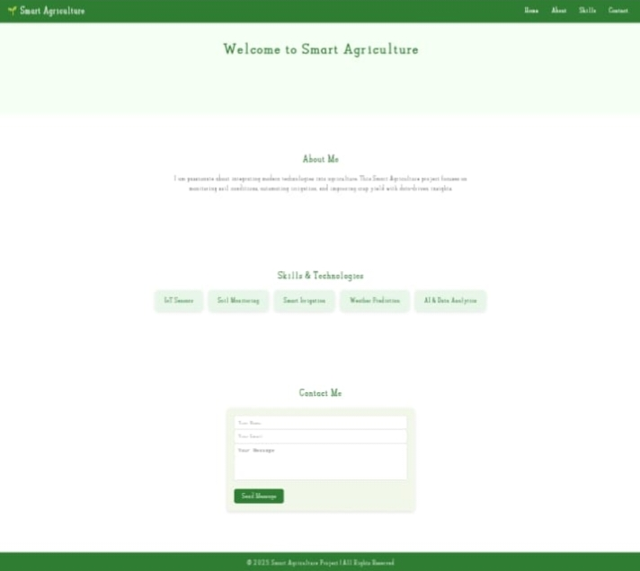

RESULTS AND SCREENSHOTS
3/21/2024 Annual Review
10

Slide 11
CONCLUSION
Agriculture is the backbone of human survival and economic growth, as it provides food, raw materials, and employment opportunities. With modern technology and sustainable practices, agriculture can meet the growing needs of the population while protecting natural resources. A strong agricultural system ensures food security, rural development, and a healthier future for society.
11

